Slide 1
Data Standards for Collaboration
F. Cropp
2025-10-07

Slide 2
Purpose
To facilitate collaboration, particularly between institutions
A standard format allows for easy sharing, standardized model creation, interoperability
Short- to mid-term goal: use a mutually-agreed-upon format to share data
To these ends, a prototype is here: https://github.com/ericcropp/Data_Standard
Looking for feedback!
Long-term goal:
For this effort to become a true standard to go alongside other standards in the field, such as:
The in-development PALS standard for lattices (https://pals-project.readthedocs.io/en/latest/)
OpenPMD ParticleGroup for particle distributions (https://christophermayes.github.io/openPMD-beamphysics/)
Note that the data standard should incorporate these (store ParticleGroups and lattices).

Slide 3
Detailed considerations for the prototype
Want a single standard for simulation and experimental data
Toward digital twins/virtual accelerator work and model calibration efforts
Want a flexible structure that can handle multiple data types:
Scalars (or lists thereof; implemented)
Images (implemented)
ParticleGroups (implemented)
Waveforms (future)
Other → let me know
Lattice vs. “Input” structures
Somewhat redundant (i.e. a lot of inputs could be stored in either)
The goal: utilize a standardized lattice (PALS) and specify a version
Inputs override lattice elements (i.e. only specify differences)
Batches vs runs
Each H5 file represents a single run (shot) of the accelerator or simulation
Batch-level YAMLs index these, but summary data are also stored in each H5’s attributes
In the repo, find:
Example simulation batch
Example real data batch
Script to take Lume-standard simulation files into this format
Example script to take real data into this format (your script will vary based on initial format)
Python classes that define the data standard (with type validation, etc).

Slide 4
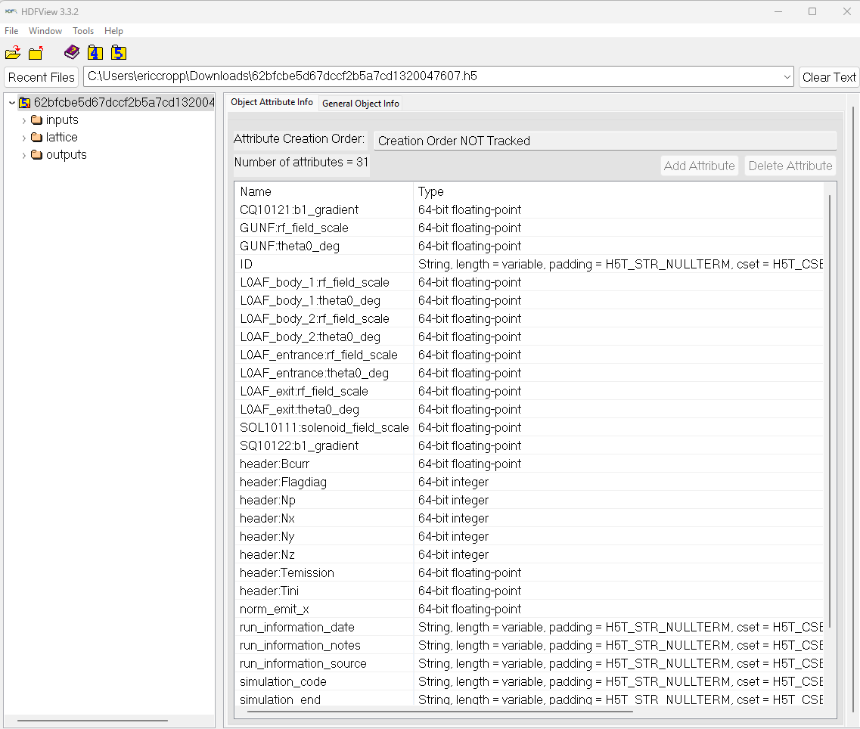
The Format
1
2
Files are stored as a .h5 file with a unique ID
Unique ID → hash derived from inputs/lattice
Idea: if the inputs/lattice are the same, no need for a second file (for discussion)
3 categories: inputs, outputs, lattice
File metadata is a summary of run info, scalar inputs and user-requested outputs
3

Slide 5
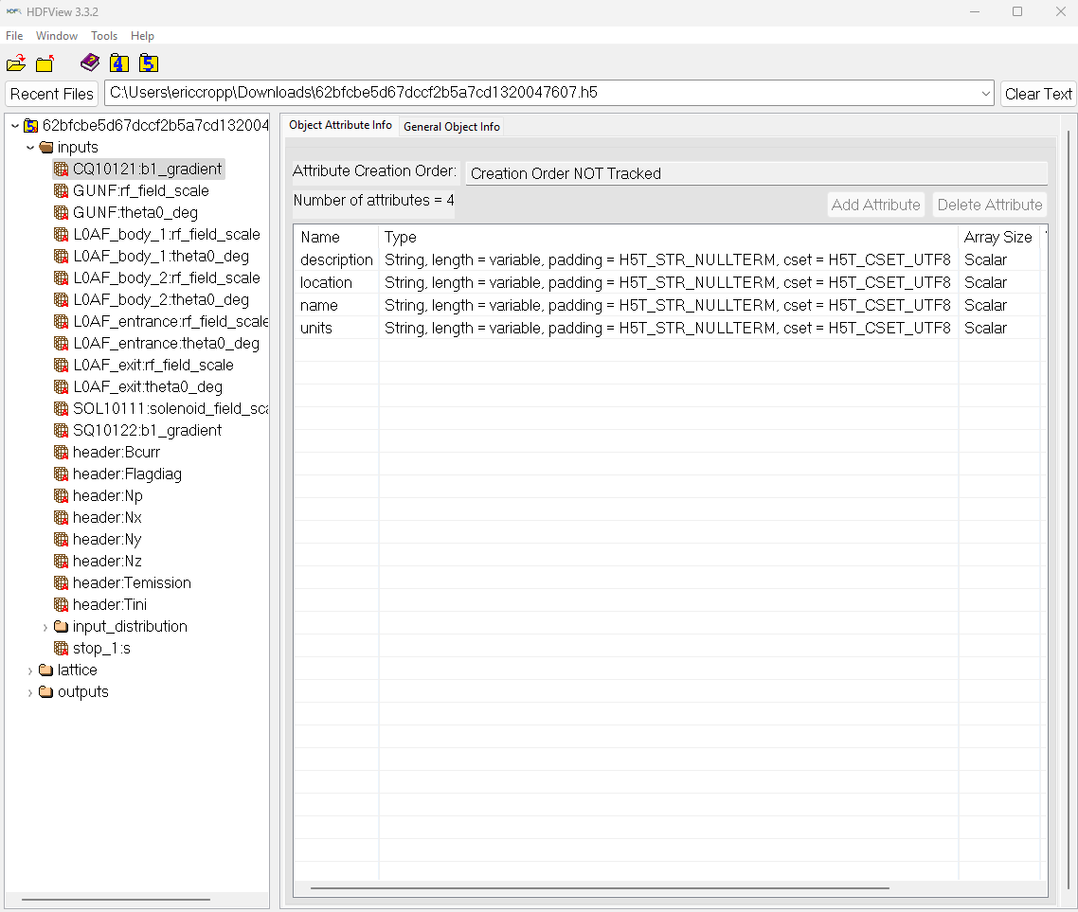
Inputs
1
Inputs are listed by the name in the lattice file (using custom lattice – see next slide)
Attributes include
Location (lattice element or s position)
Name (in lattice)
Optional: Description → no rules, just flexible place to put a comment
Optional: units
Input distribution: a ParticleGroup object (accepts 2-D np array, too, IFF pixel calibration is specified in attributes)
2
3

Slide 6
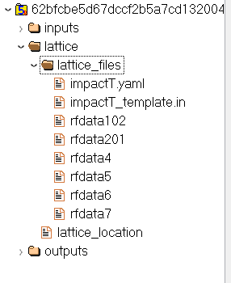
Lattice
Intentionally bare-bones → no need to duplicate effort (PALS standard)
The key here is to specify data about the state of the accelerator
Consistent within batch is okay for now
Needs to be enough to re-run simulations
Lattice location: path (or link) to the lattice location
If lattice_location==‘included’, must include lattice_files
For custom lattices
2
1

Slide 7
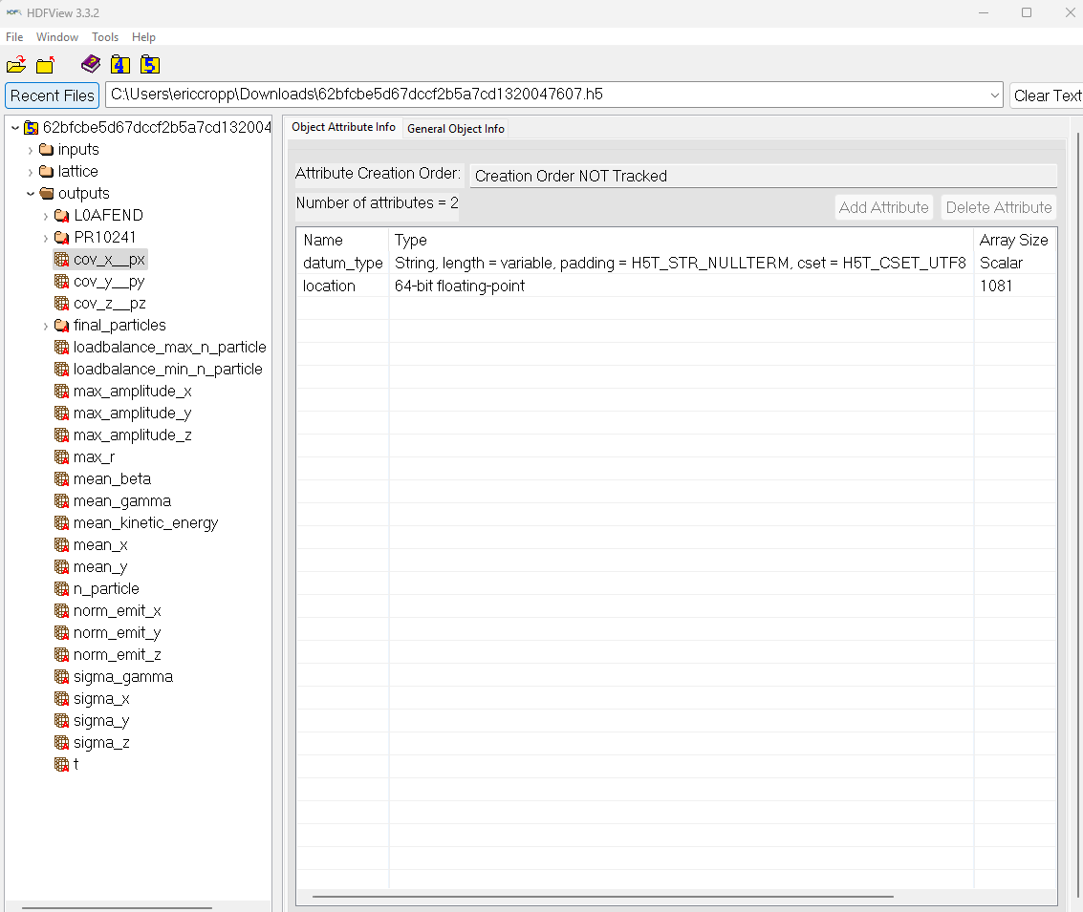
Outputs
List of outputs (by type of readout)
Particles from simulation (ParticleGroup object)
Metadata: data type and location
Location must be a float (s-position), string (lattice element name) or list of these of same length of the length of the data
3
2
4
1

Slide 8
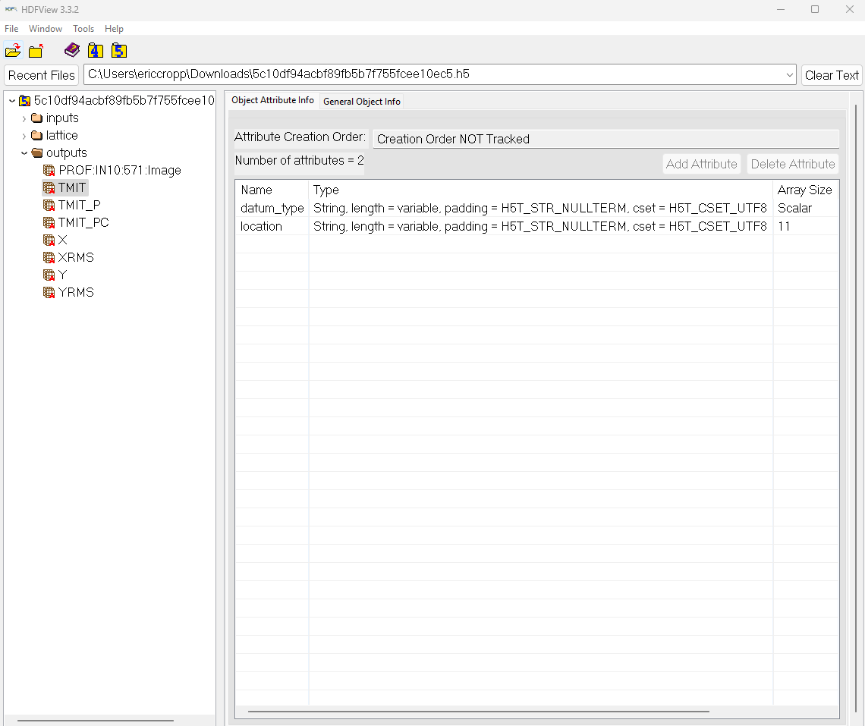
Output example from real data
Outputs listed by readout type
Screen image (pixel calibration is specified in attributes)
Location is list of measured locations (in this case different nondestructive charge readings)
2
3
1

Slide 9
Future Considerations
Unique hash for each file vs inputs/lattice only
Other data types
Batch sharing → single file combining info in multiple h5 files
Advantage: can remove duplicate information
Lattice files
Input distributions if repeated
PALS integration/collaboration
https://pals-project.readthedocs.io/en/latest/
Questions/comments/thoughts/ concerns?

